Slide 1
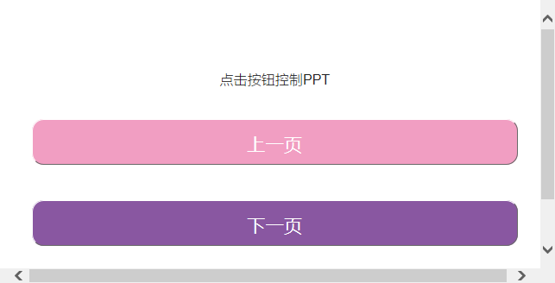
Slive For Slack
五轴飞行器
2016/7/3
Begin

Slide 2
SLive For Slack
五轴飞行器
2016/7/3
GO

Slide 3
What’s Slive?

Slide 4



Slide 5
Teamwork
Presentation

Slide 6
Bot

Slide 7
Engagement

Slide 8
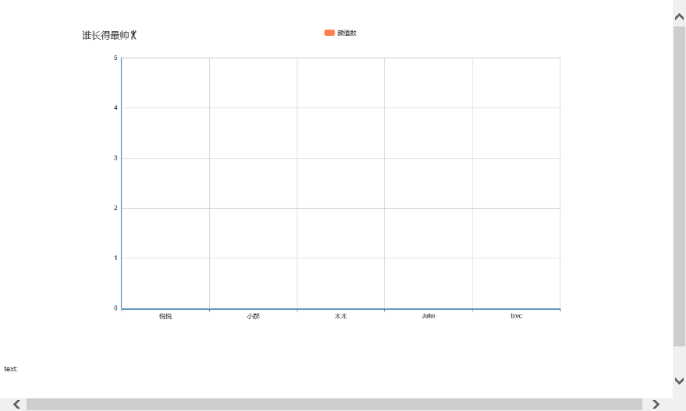
Engagement

Slide 9
Pre-presentation
Manual

Slide 10
Tradition

Slide 11
Bot

Slide 12
File

Slide 13
Code

Slide 14
Datasheet

Slide 15
……

Slide 16


Slide 17
Push to channel

Slide 18
HTTPS?

Slide 19
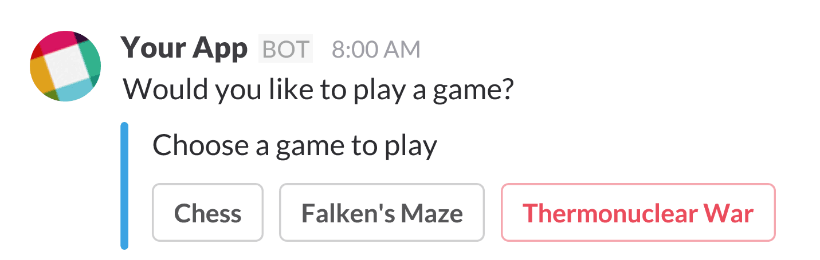

Slide 20
Generate Report

Slide 21
Auto Reply / Quiz

Slide 22
Context Sense Assistant

Slide 23
Better Assistant

